Slide 1
Program Name goes here
Link to github Repository: Luka-Timtam/Pizza-Bot: A bot for ordering Pizza's (github.com)
Links to trello board / project management tools: https://trello.com/b/pf0Lmbsm/pizza-bot-initial-plan
You MUST provide evidence showing how the problem has been decomposed, how the components have been developed and trialled, and of how they have been assembled and tested to create a final, working outcome.

Slide 2
Relevant Implications
Explain the relevant implications here. Please watch this video to learn how to do this.
Notes:
Explain the relevant implications here. Then as you work, develop your code, discuss how the implications are being met.

Slide 3
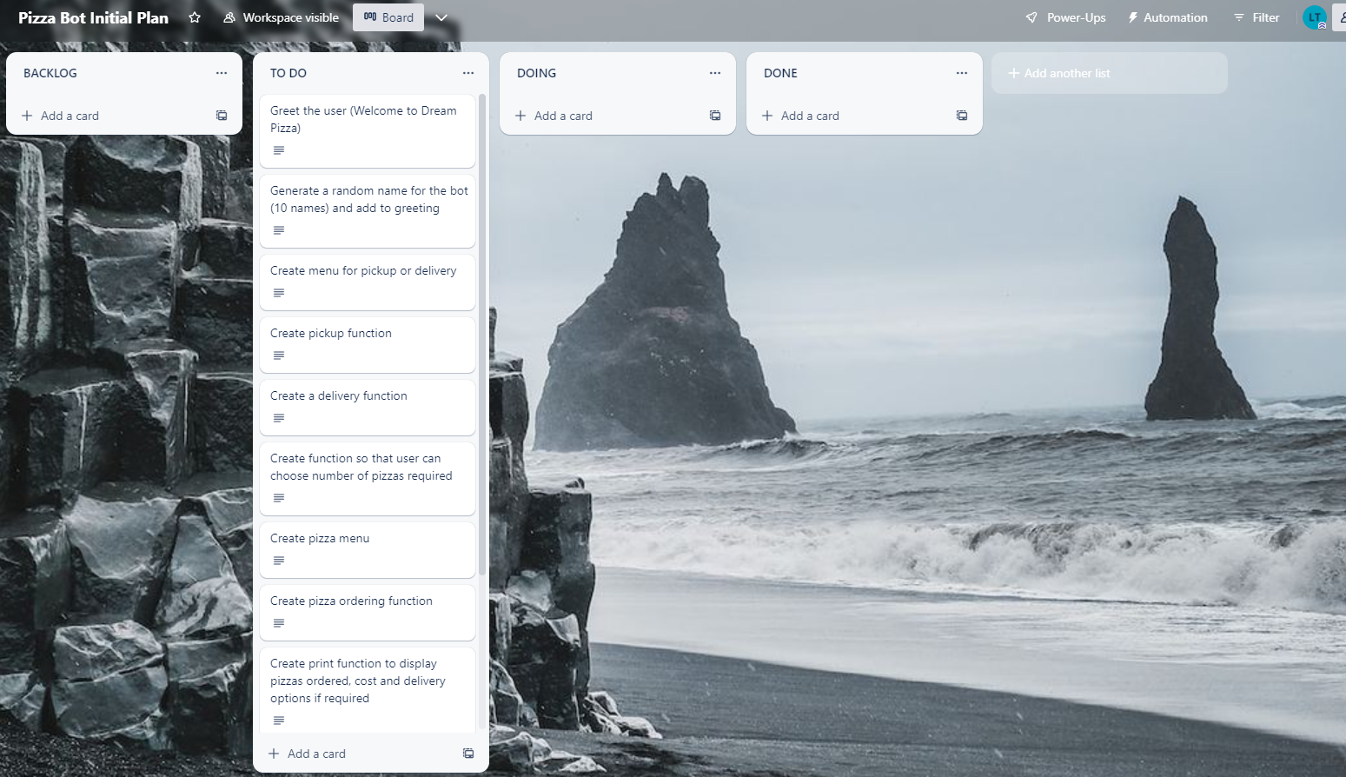
Decomposition
Notes:
Paste screenshots of your initial Trello board / task decomposition on this slide. If you have a long list, you might need to break it up into several columns. Delete this instruction when you are done.

Slide 4
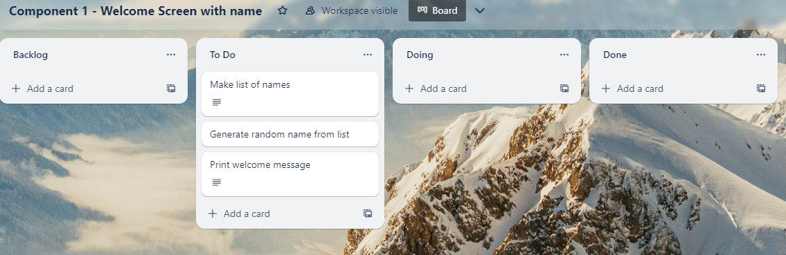
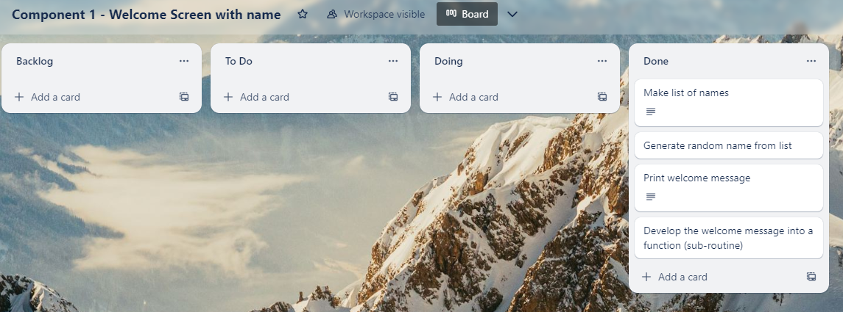
Component 1 (Trello screenshot) Version 1 Version 2

Slide 5
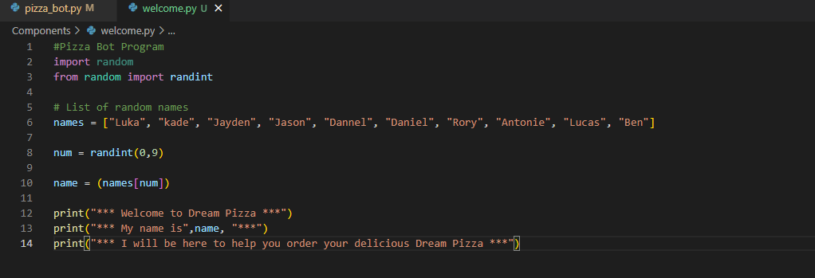
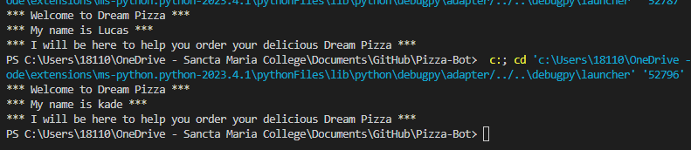
Component 1 - Test Plan (?and screenshot)
Test Case | Expected Values
Run program | Print welcome message with random name from list of names – Runs correctly

Slide 6
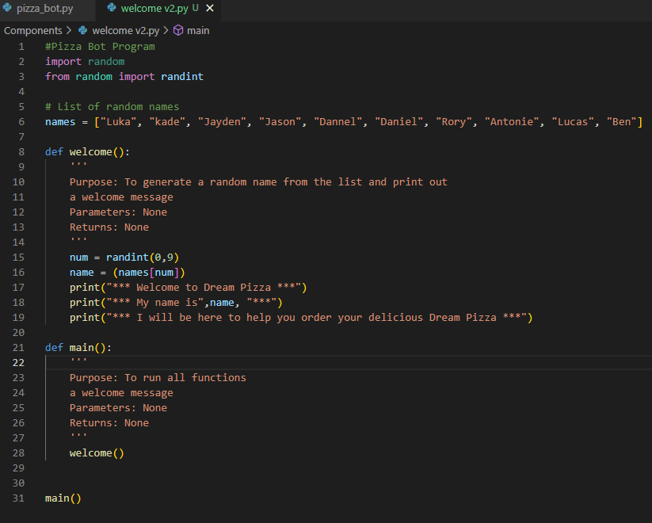
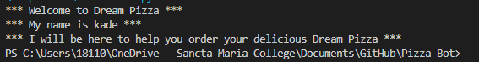
Component 1 version 2 - Test Plan (?and screenshot)
Test Case | Expected Values
Run program | Main and welcome run correctly. Welcome message prints with random name.

Slide 7
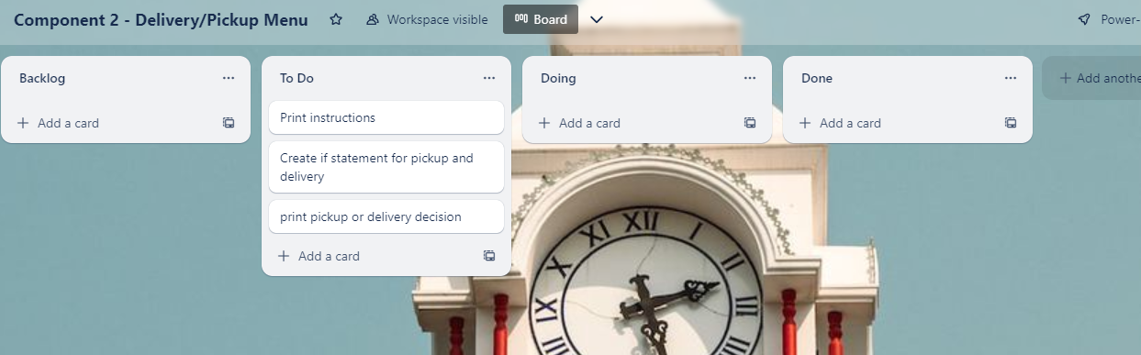
Component 2 (Trello screenshot)

Slide 8
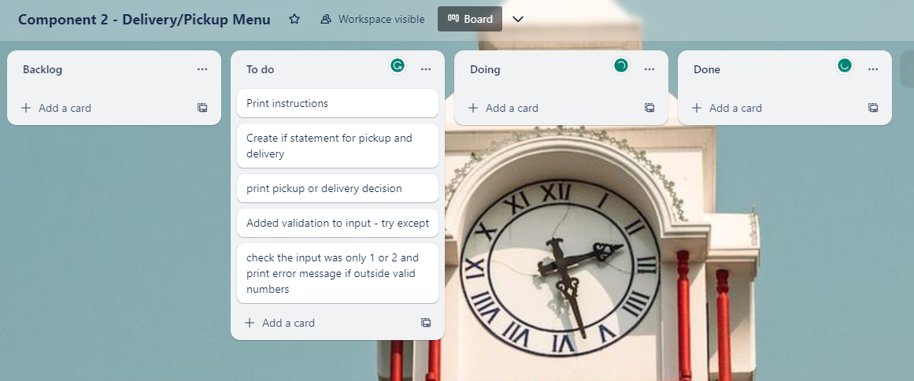
Component 2 Version 2(Trello screenshot)

Slide 9
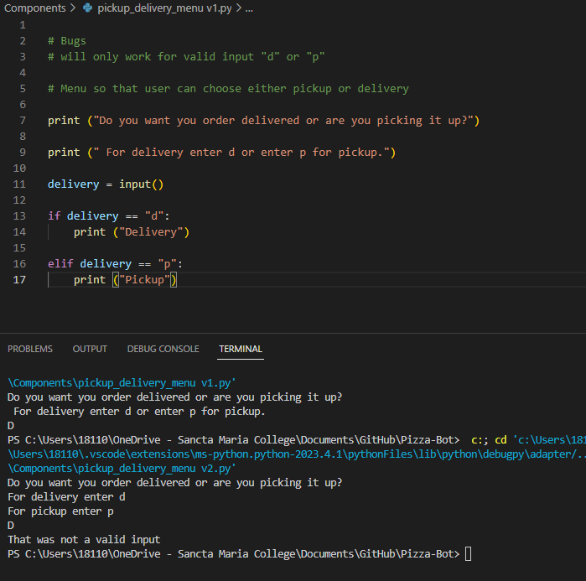
Component 2 version 1 - Test Plan (?and screenshot)
Test Case | Expected Values
Run program | Enter p program prints pickup Enter d program prints delivery Enter invalid program stops

Slide 10
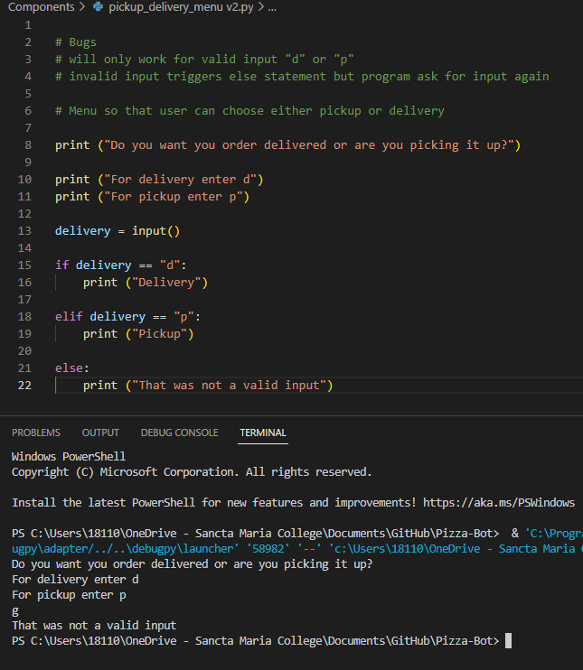
Component 2 version 2 - Test Plan (?and screenshot)
Test Case | Expected Values
Run program | Enter p program prints pickup Enter d program prints delivery Enter invalid prints error message

Slide 11
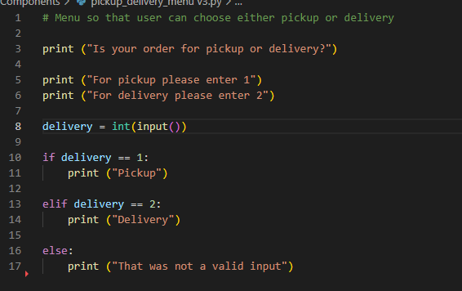
Component 2 version 3 - Test Plan (?and screenshot)
Test Case | Expected Values
Run program | Enter 1 program prints pickup Enter 2 program prints delivery Enter invalid program displays value error.

Slide 12
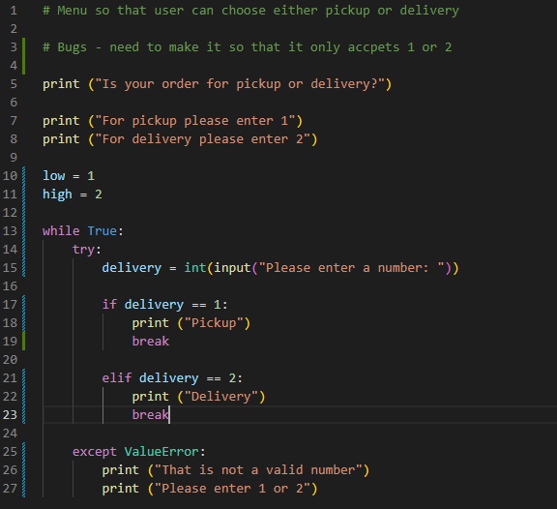
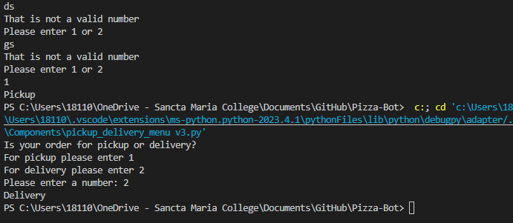
Component 2 version 4 - Test Plan (?and screenshot)
Test Case | Expected Values
Run program | Enter 1 program prints pickup Enter 2 program prints delivery Enter invalid entry - prints error message Enter number other than 1 or 2 does not work – error message asks for entry again

Slide 13
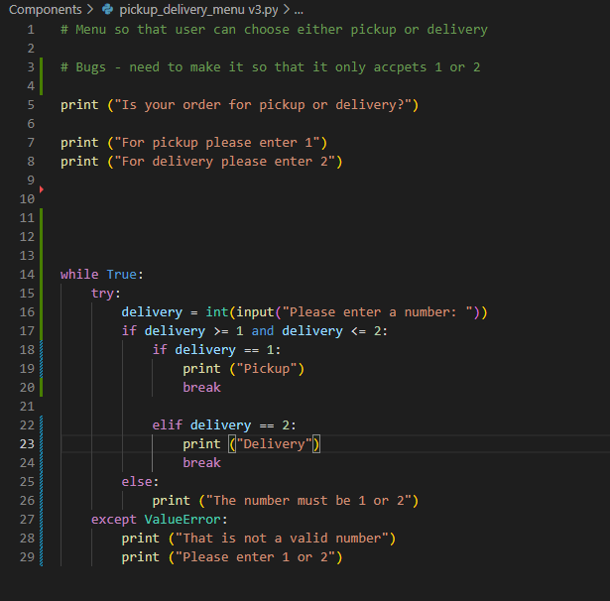
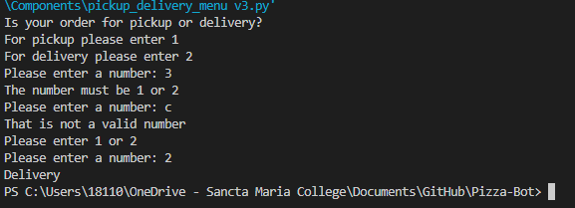
Component 2 version 5 - Test Plan (?and screenshot)
Test Case | Expected Values
Run program | Enter 1 program prints pickup Enter 2 program prints delivery Enter invalid prints error message then asks for input again Enter number other than 1 or 2 does not work

Slide 14
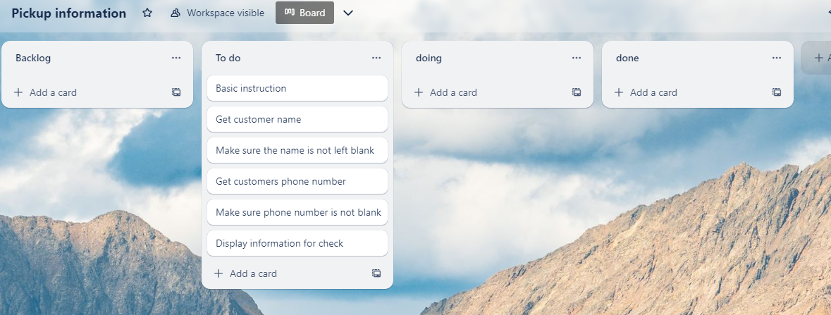
Component 3 Pick up Version 1(Trello screenshot)

Slide 15
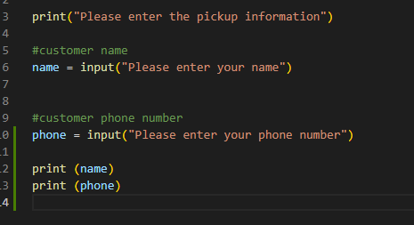
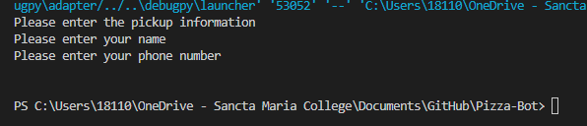
Component 3 version 1 - Test Plan (?and screenshot)
Test Case | Expected Values
Input name Input phone number Left input blank | Printed name correctly Printed phone number correctly Accepted blank and printed blank input

Slide 16
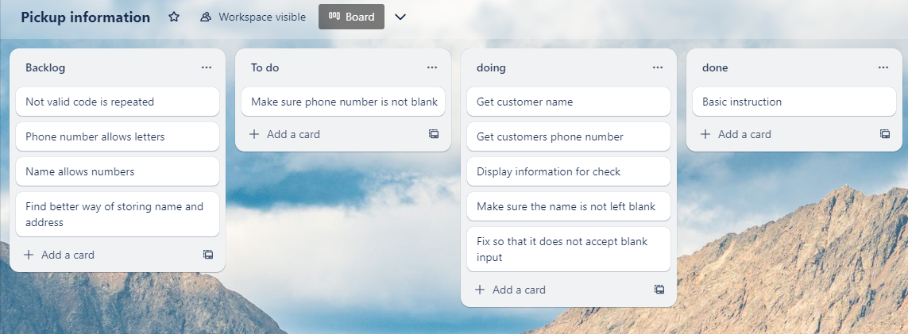
Component 3 Pick up Version 2(Trello screenshot)

Slide 17
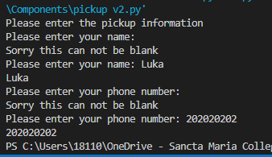
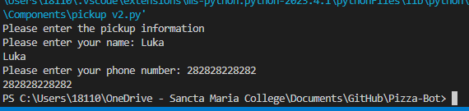
Component 3 version 2 - Test Plan (?and screenshot)
Test Case | Expected Values
Input name Input phone number Left input blank | Printed name correctly Printed phone number correctly Prints “Sorry this can not be blank” – goes back to input

Slide 18
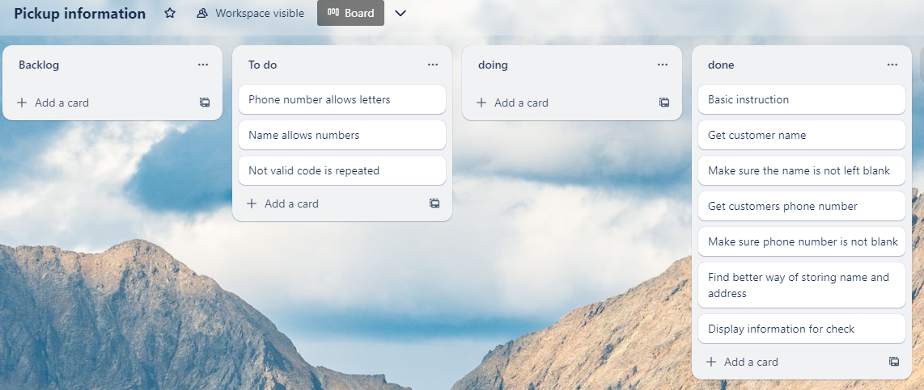
Component 3 Pick up Version 3(Trello screenshot)

Slide 19
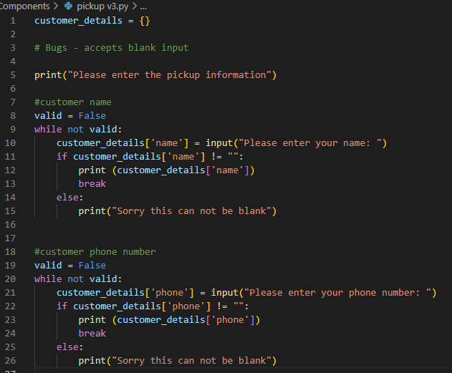
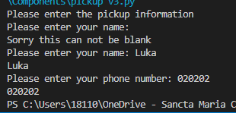
Component 3 version 3 - Test Plan (?and screenshot)
Test Case | Expected Values
Input name Input phone number Left input blank | Printed name correctly Printed phone number correctly Prints “Sorry this can not be blank” – goes back to input

Slide 20
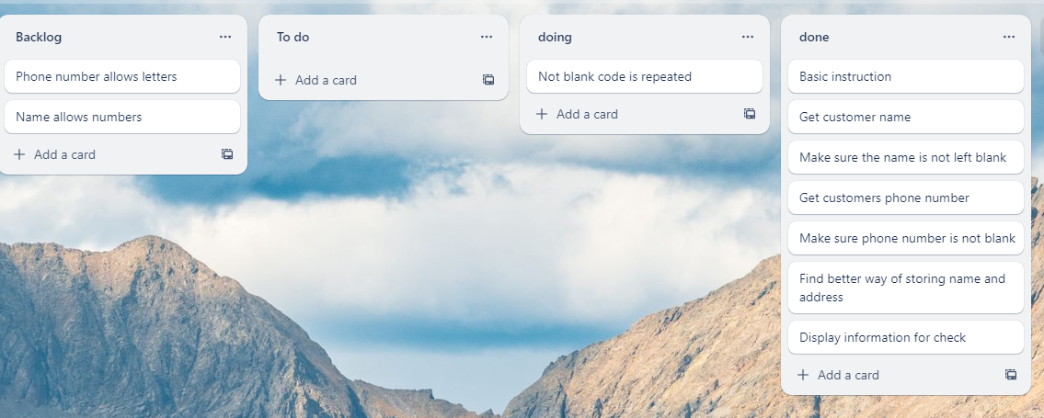
Component 3 Pick up Version 4(Trello screenshot)

Slide 21
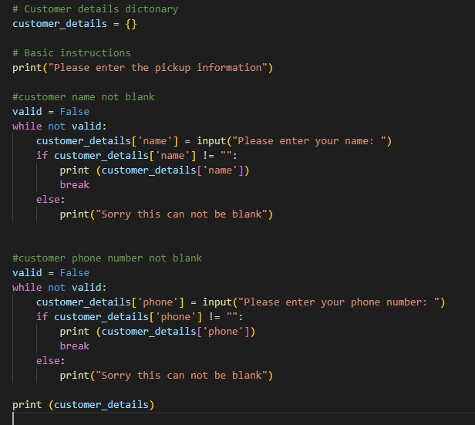
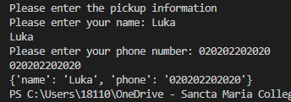
Component 3 version 4 - Test Plan (?and screenshot)
Test Case | Expected Values
Input name Input phone number Left input blank | Printed name correctly Printed phone number correctly Prints “Sorry this can not be blank” – goes back to input

Slide 22
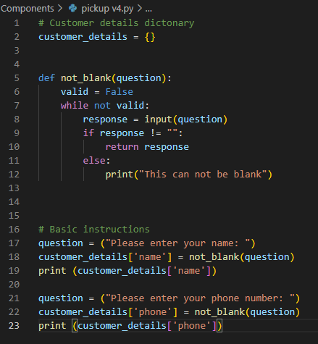
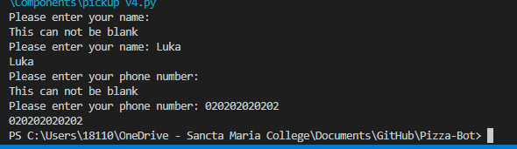
Component 3 version 4 - Test Plan (?and screenshot)
Test Case | Expected Values
Input name Input phone number Left input blank | Printed name correctly Printed phone number correctly Prints “Sorry this can not be blank” – goes back to input

Slide 23
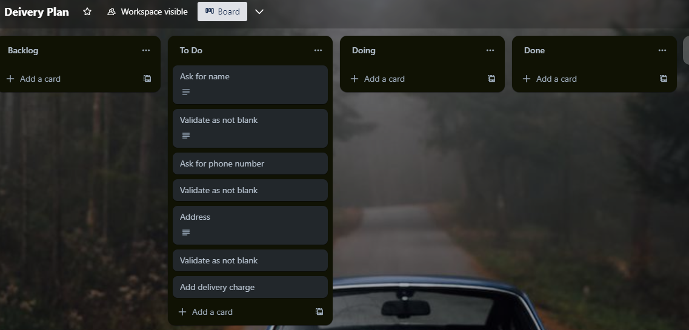
Component 4 delivery info(Trello screenshot)

Slide 24
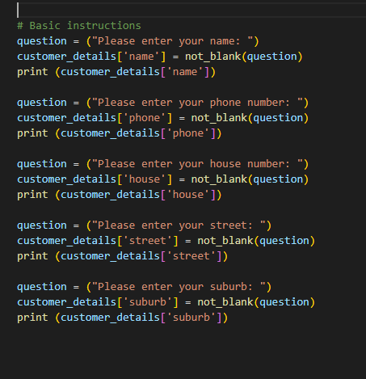
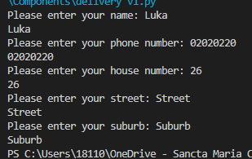
Component 4 Delivery info v1 - Test Plan (?and screenshot)
Test Case | Expected Values
Input name Input phone number Input house number Input street name Input suburb Left input blank | Printed name correctly Printed phone number correctly Prints “Sorry this can not be blank” – goes back to input Printed street name, suburb and house number correctly

Slide 25
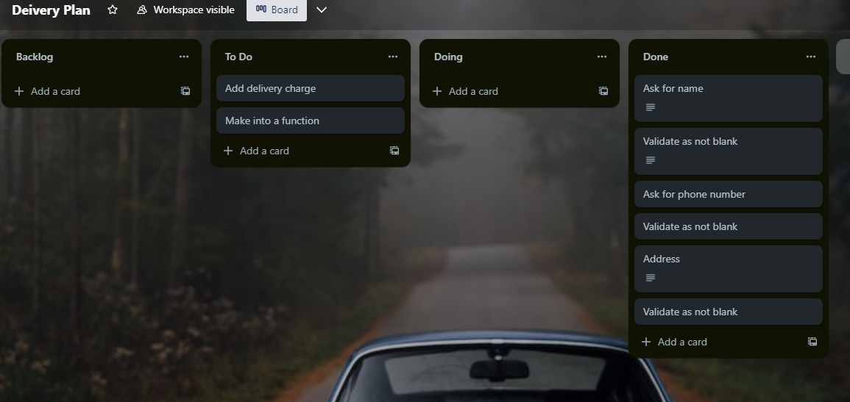
Component 4 delivery info v2(Trello screenshot)

Slide 26
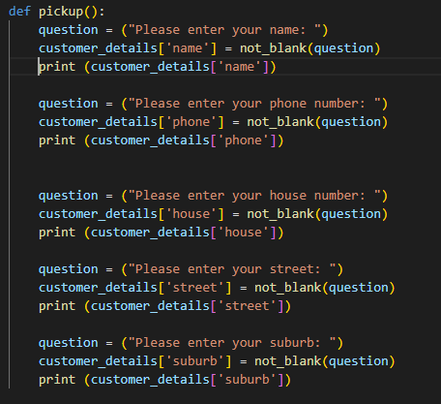
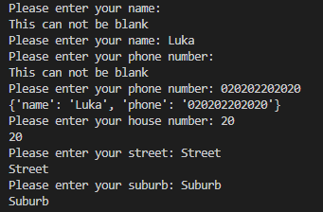
Component 4 Delivery info v2 - Test Plan (?and screenshot)
Test Case | Expected Values
Input name Input phone number Input house number Input street name Input suburb Left input blank | Printed name correctly Printed phone number correctly Prints “Sorry this can not be blank” – goes back to input Printed street name, suburb and house number correctly

Slide 27
Component 4 delivery info v2(Trello screenshot)

Slide 28
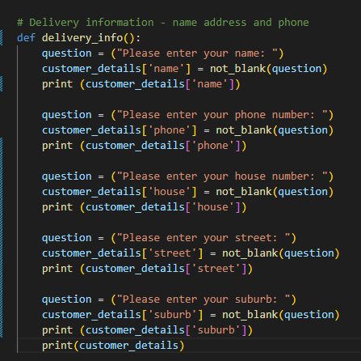
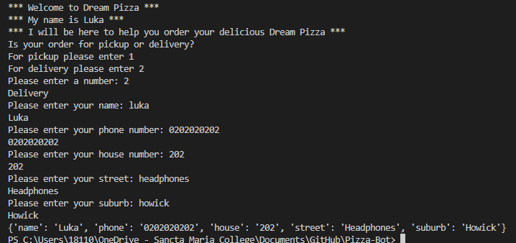
Component 4 Delivery info v2 - Test Plan (?and screenshot)
Test Case | Expected Values
Input name Input phone number Input house number Input street name Input suburb Left input blank | Printed name correctly Printed phone number correctly Prints “Sorry this can not be blank” – goes back to input Printed street name, suburb and house number correctly

Slide 29
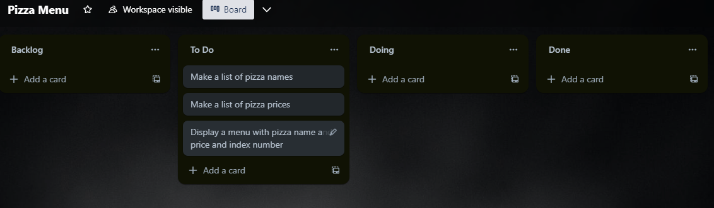
Component 5 pizza menu(Trello screenshot)

Slide 30
Component 5 pizza menu v1(Trello screenshot)

Slide 31
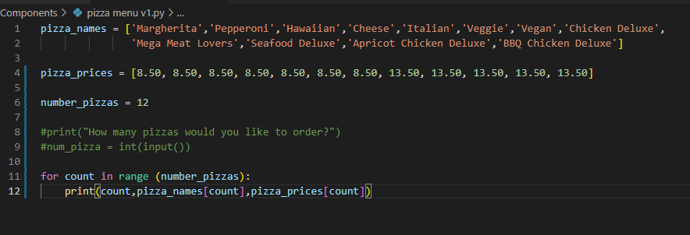
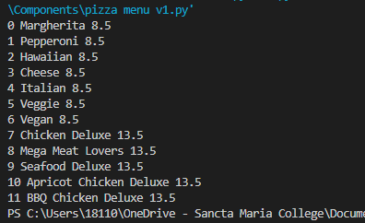
Component 5 pizza menu v1 - Test Plan (?and screenshot)
Test Case | Expected Values
Run file | Printed a list with index number, pizzas and prices

Slide 32
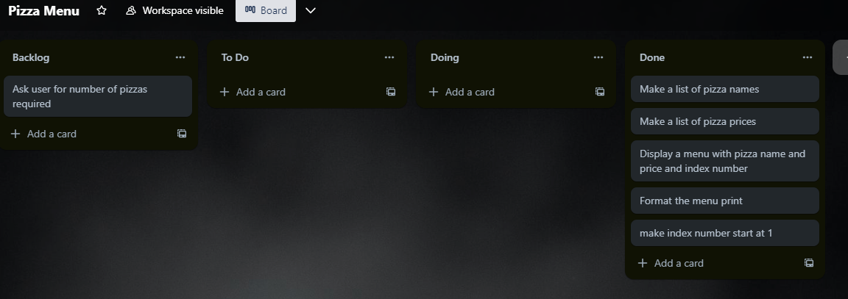
Component 5 pizza menu v2(Trello screenshot)

Slide 33
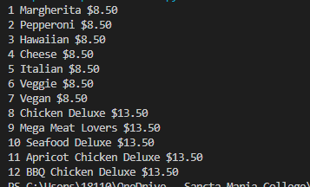
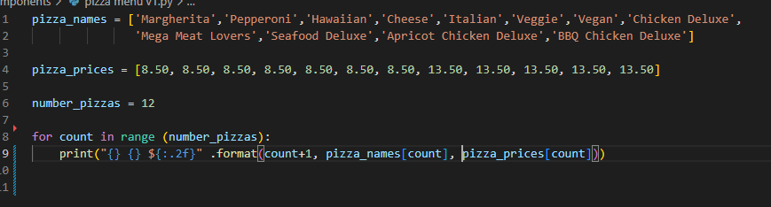
Component 5 pizza menu v2 - Test Plan (?and screenshot)
Test Case | Expected Values
Run file | Printed a list with index number, pizzas and prices With price formatted to 2 decimal places and dollar sign. Menu starts at 1.

Slide 34
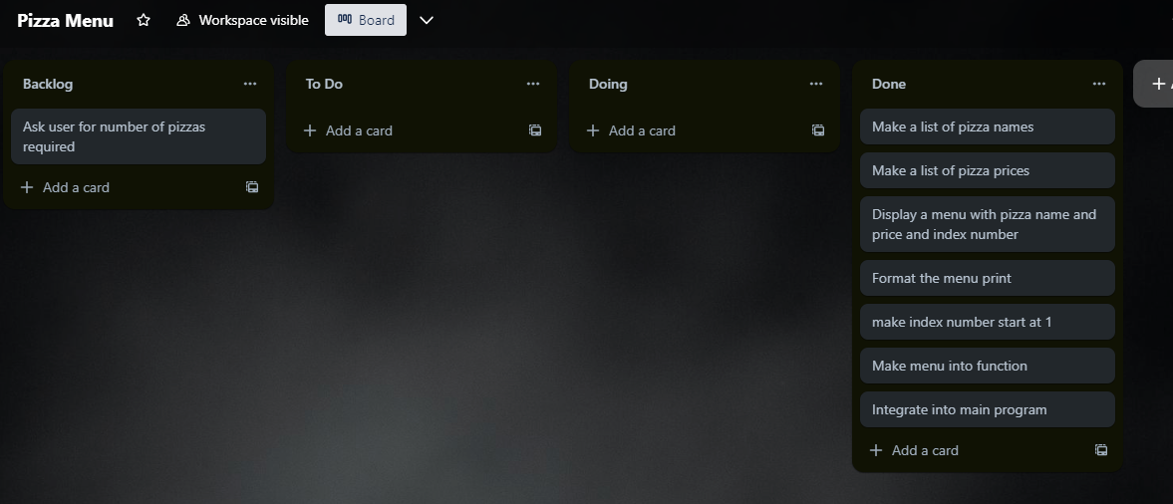
Component 5 pizza menu v3(Trello screenshot)

Slide 35
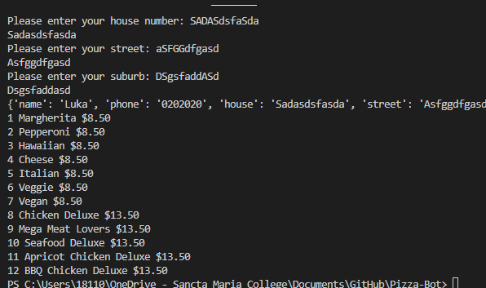
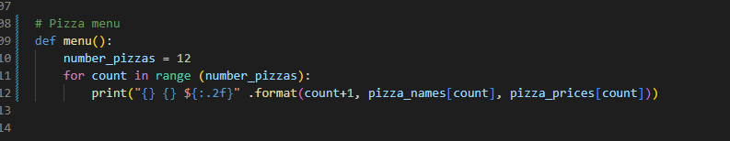
Component 5 pizza menu v3 - Test Plan (?and screenshot)
Test Case | Expected Values
Run file | Printed a list with index number, pizzas and prices With price formatted to 2 decimal places and dollar sign. Menu starts at 1.

Slide 36
Version Control Evidence
Your version control evidence should go here. This could be in the form of annotated screenshots which show you you managed this process or you could make a brief screencast explaining how you implemented version control.
Notes:
Your version control evidence should go here. This could be in the form of annotated screenshots which show you you managed this process or you could make a brief screencast explaining how you implemented version control.

Slide 37
Discusses how the information from planning, testing and trialling of components assisted in the development of a high-quality outcome
Notes:
Discusses how the information from planning, testing and trialling of components assisted in the development of a high-quality outcome

